Slide 1
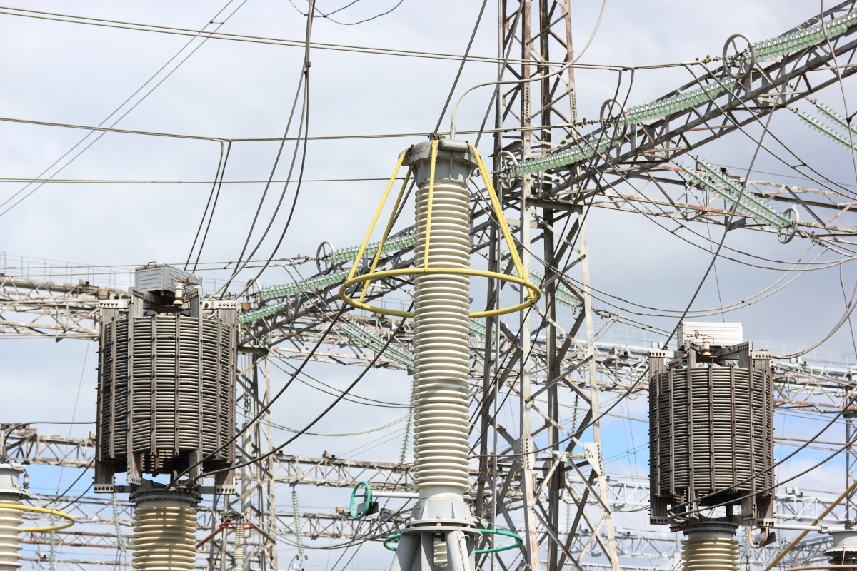
Electricity Bill Management System
By
Mr. vishwambhar Sumit bharat
Mr . Bodkhe Nilesh Laxman

Slide 2
Introduction
Electricity Billing System is a software-based application.
This project aims at serving the department of electricity by computerizing the billing system.
It mainly focuses on the calculation of units consumed during the specified time and the money to be charged by the electricity offices.
This computerized system will make the overall billing system easy, accessible, comfortable, and effective for consumers.
To design the billing system more service oriented and simple, the following features have been implemented in the project. The application has high speed of performance with accuracy and efficiency.

Slide 3
Existing system
The conventional system of electricity billing is not so effective; one staff must visit each customer’s house to note the meter readings and collect the data. Then, another staff must compute the consumed units and calculate the money to be paid. Again, the bills prepared are to be delivered to customers. Finally, individual customer must go to electricity office to pay their dues.
Hence, the conventional electricity billing system is uneconomical, requires many staffs to do simple jobs and is a lengthy process overall. In order to solve this lengthy process of billing, a web based computerized system is essential. This proposed electricity billing system project overcomes all these drawbacks with the features. It is beneficial to both consumers and the company which provides electricity.

Slide 4
Requirement Analysis
Hardware Requirements:
Hardware Specification: -Pentium IV
Clock Speed: -1.5 GHz or more
System Bus: -64 bits
RAM: -2 GB
HDD: -512GB
Monitor: -LCD Monitor
Keyboard: -Standerd keyboard
Mouse: -Compatible mouse

Slide 5
Software Requirements:
Operating System: -Windows XP, Linux.
Software: - SQL Server [workbench]
Front End: -Java core/swings (NetBeans)
Back End: -My SQL

Slide 6
LIMITATIONS:
This application cannot be accessed remotely.
This application requires knowledgeable person to use this application.
This application does not have journals.

Slide 7
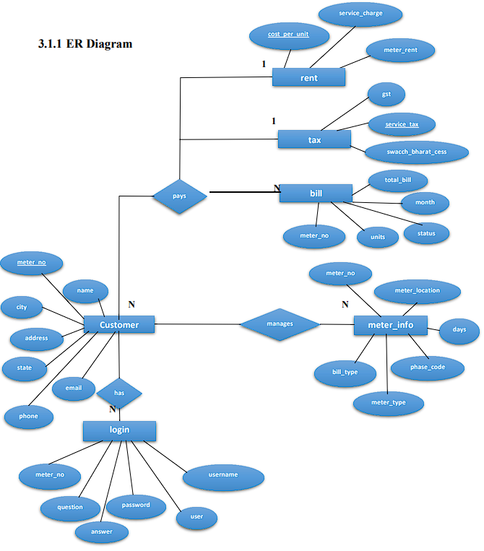
Er-Diagram

Slide 8
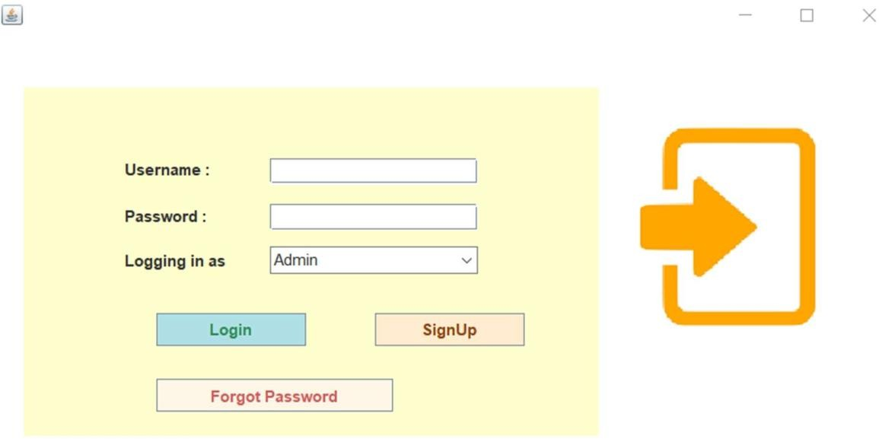
Screens
Login page
Here Customer and Admin can login to their respective accounts. The dropdown menu allows to choose whether to login as an admin or as a customer.

Slide 9
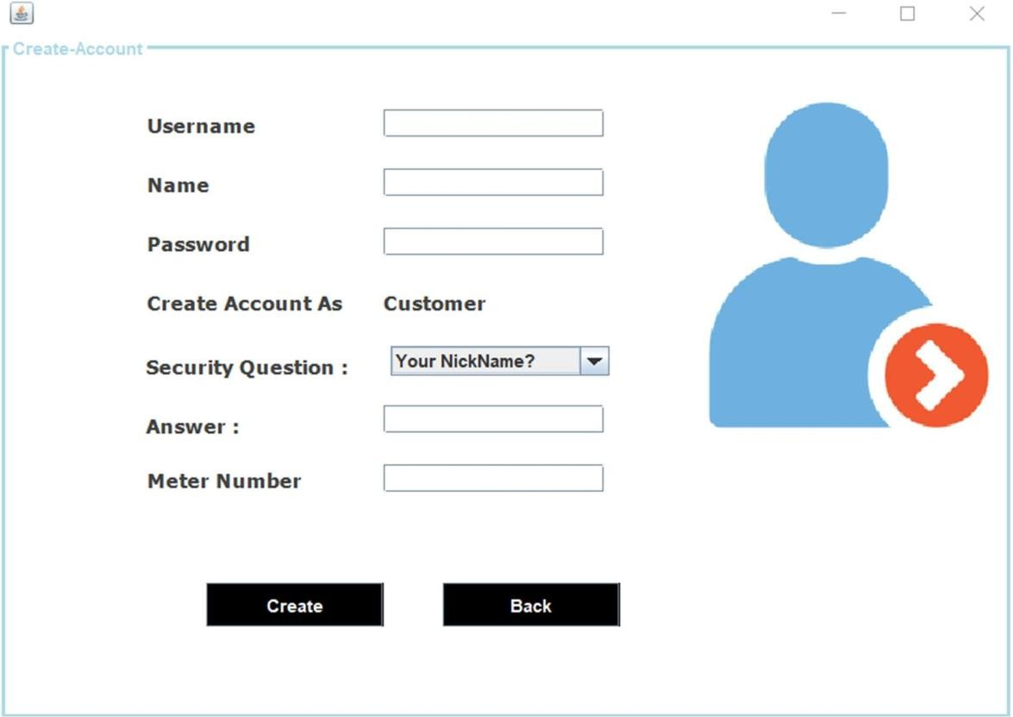
Sign Up Screen
Here New customers will signup to access their accounts.
User have to enter username, name, password, choose security question and answer to that question.
Every user must enter their unique Meter Number to complete their signup process.

Slide 10
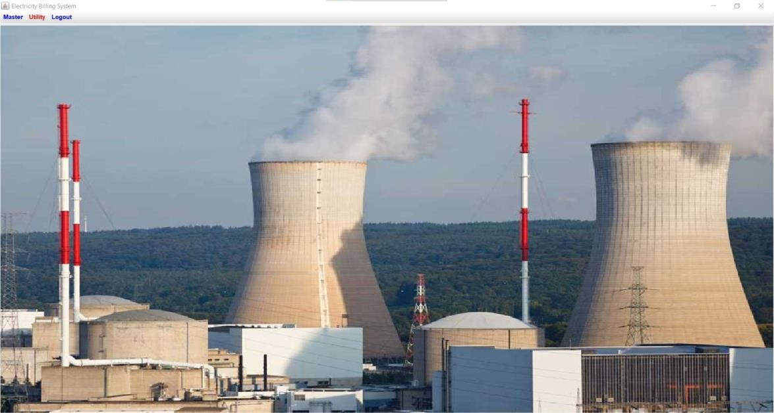
Admin’s Home Screen
Admin lands on this page after successful login.

Slide 11
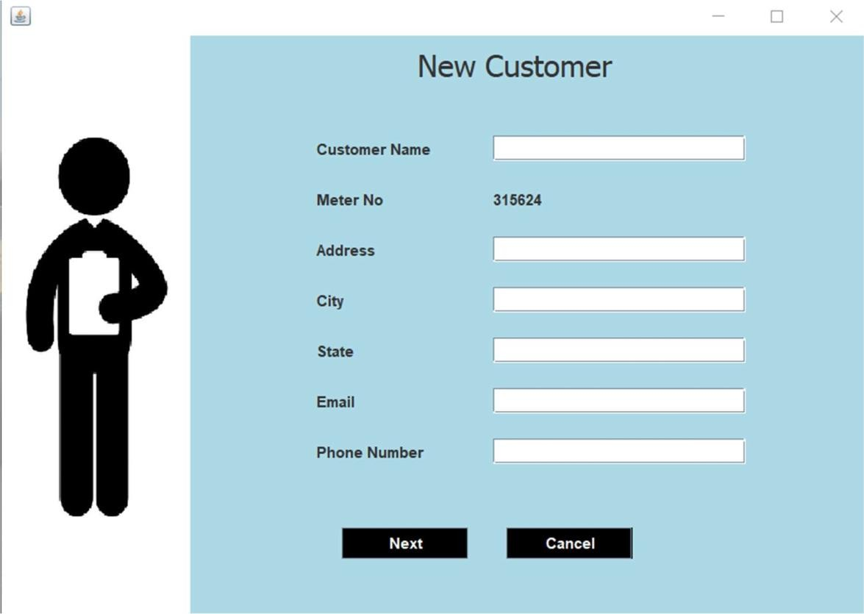
Add Customer
Here admin registers new users.
Admin enters Customer’s Name, Address, City, State, Email and Phone Number.

Slide 12
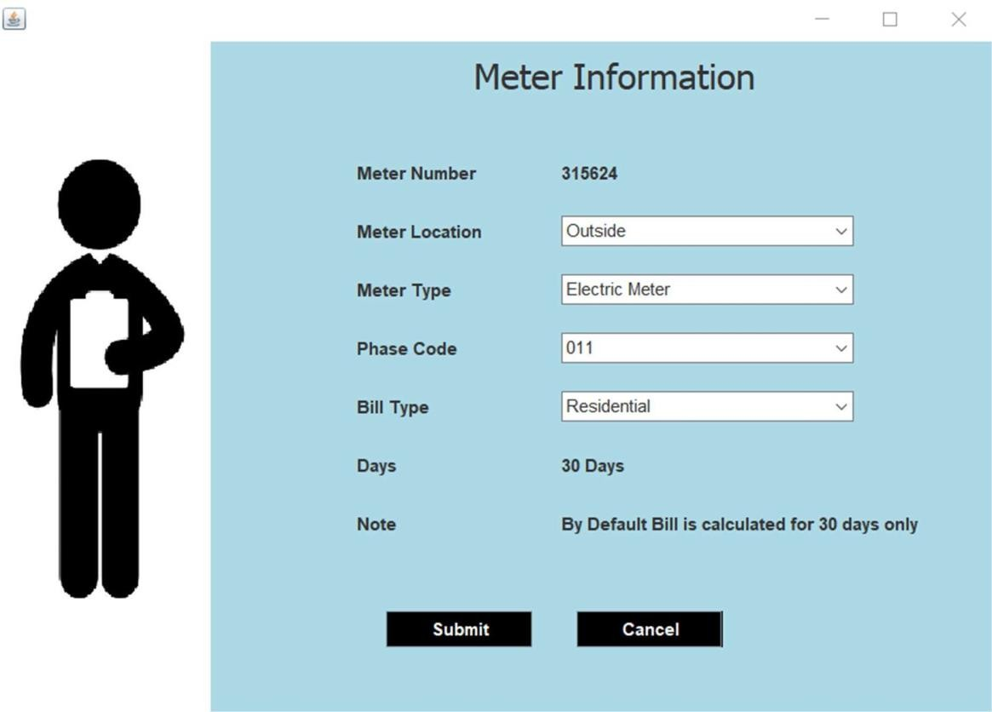
Meter information
Here Admin selects the location and type of meter installed at the customers end.
Admin also selects the phase code and Bill type i.e. Residential or Commercial/ Industrial.

Slide 13
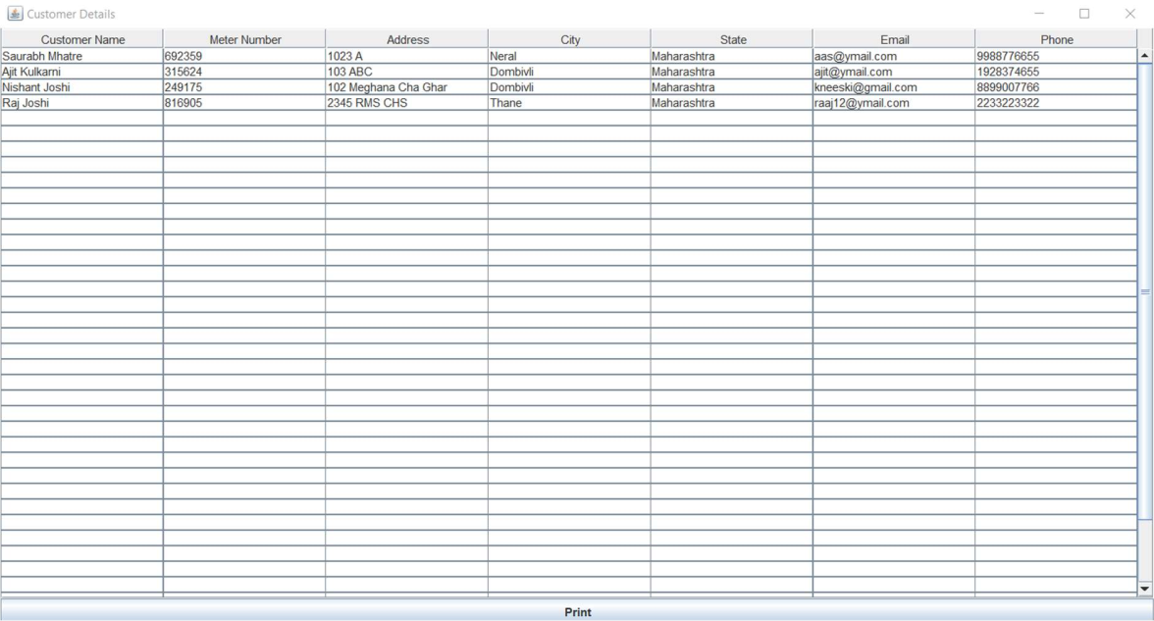
Customer Details
Here Admins can see the details of all registered customers. Admin can print these details in pdf format if the wish.

Slide 14
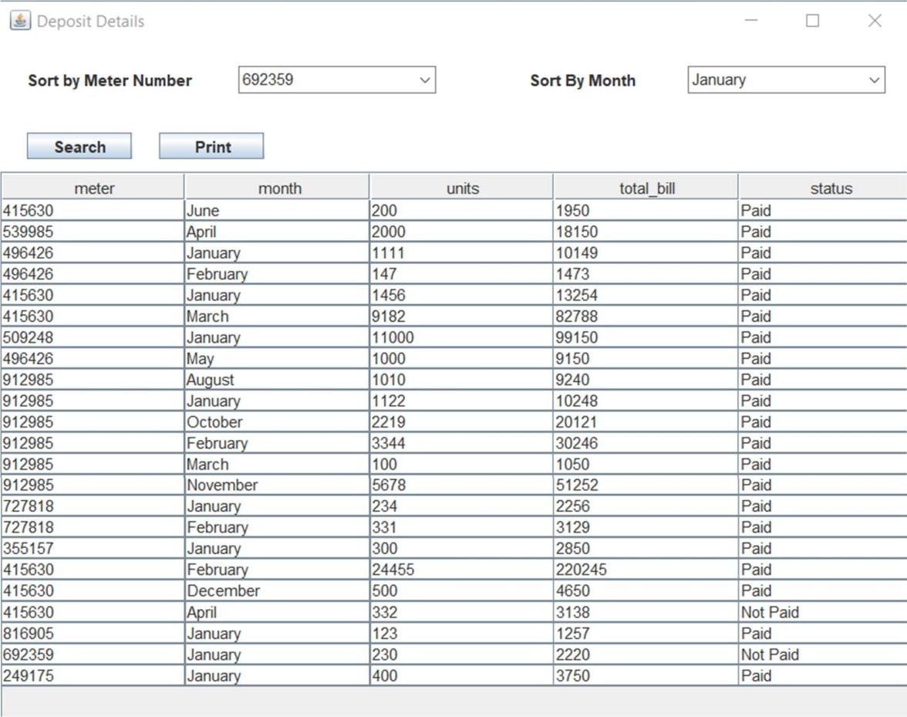
Deposit Details Screen
Here Admin can check the status whether customers have paid their bills or not.
His list can be sorted according to individual user’s meter number or according to month.
Admin can print these details in pdf format if the wish.

Slide 15
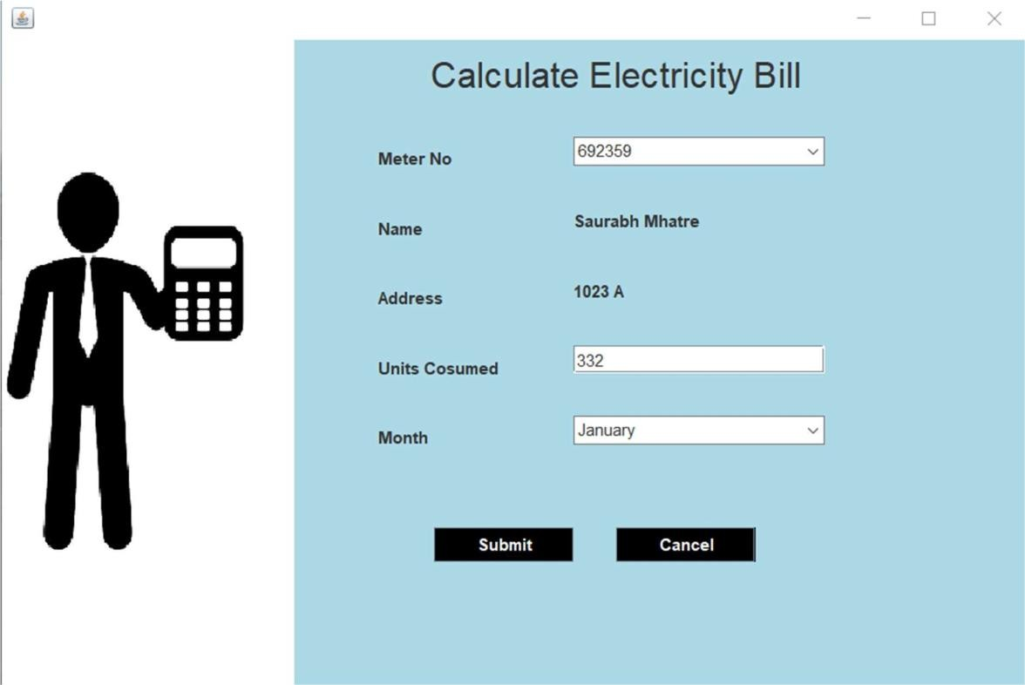
Calculate Bill Screen
Here admin calculate the bill of users by selecting appropriate meter number, units consumed and month.

Slide 16
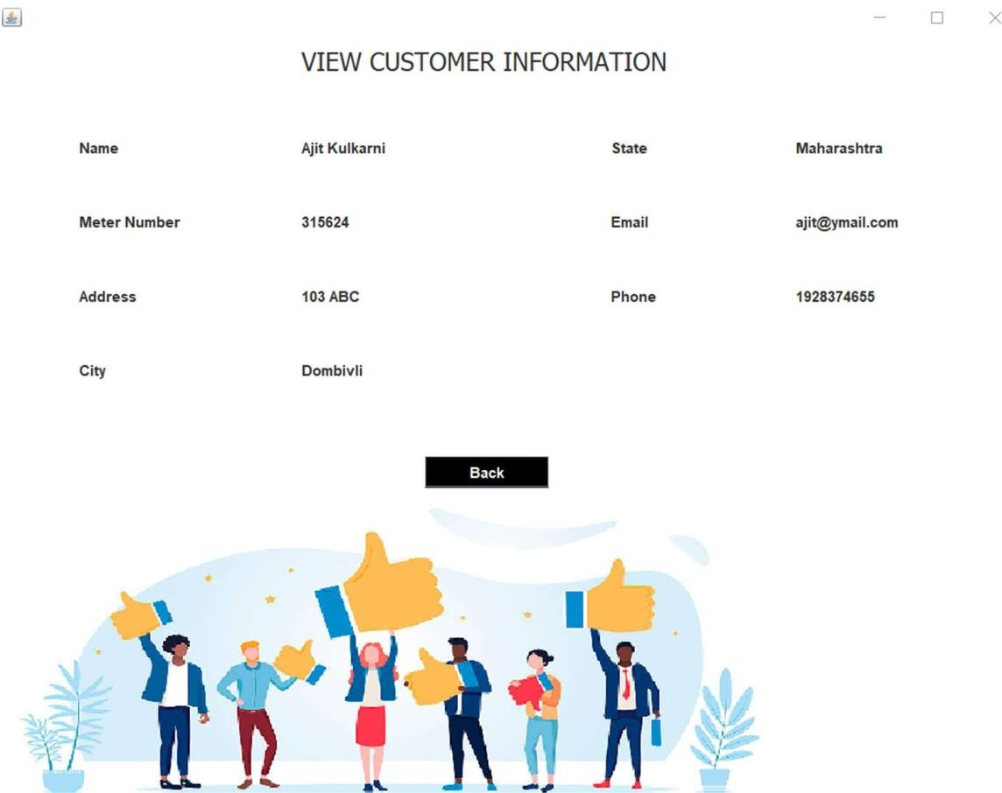
View Customer Info Screen
Here customer can see their entered information such as their name, meter number, address, city , state, email id and phone number.

Slide 17
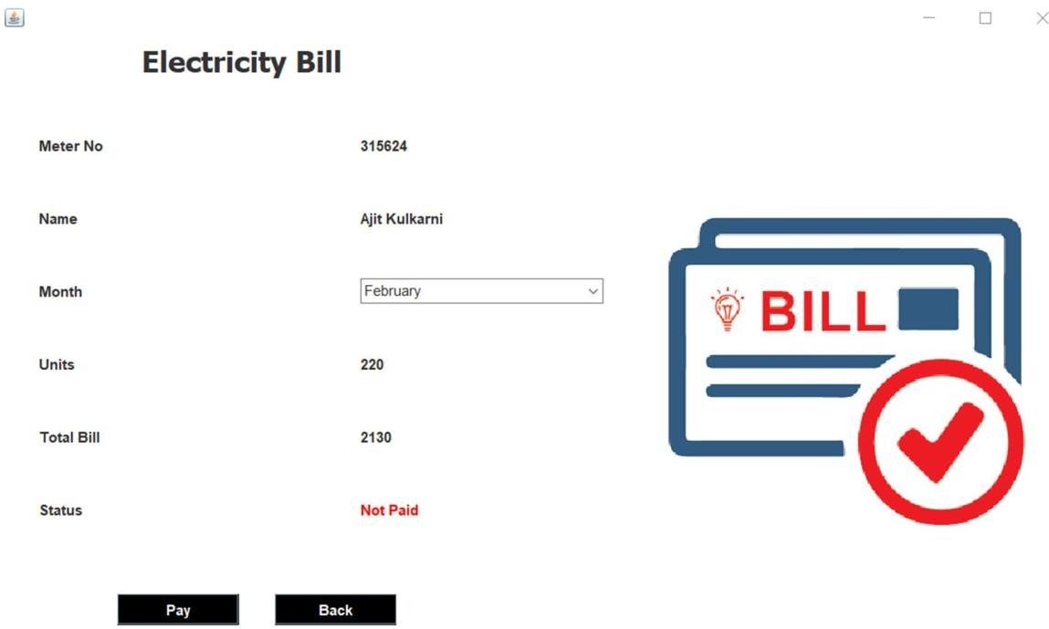
Pay Bill Screen
Here customers pay their bills by selecting appropriate month.

Slide 18
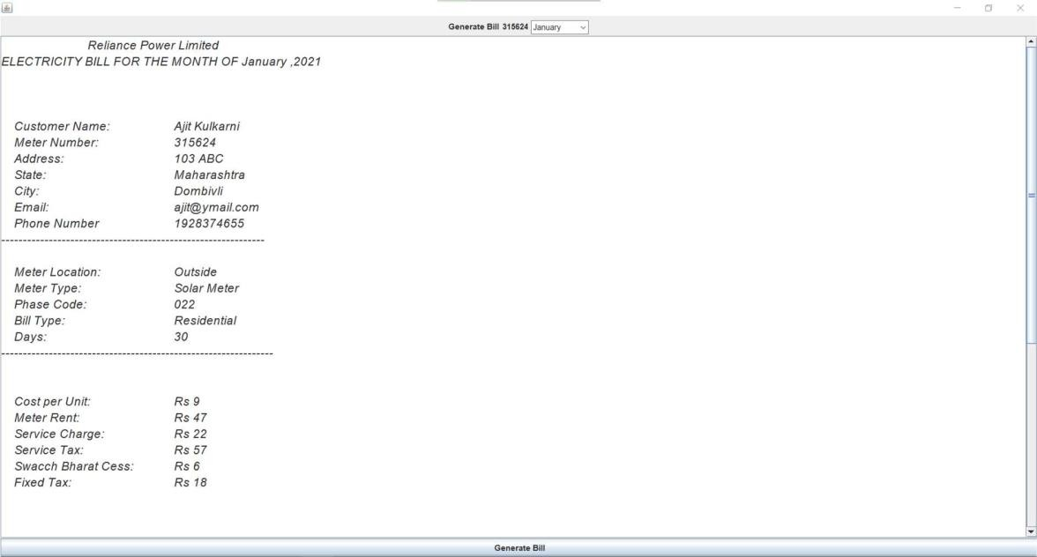
Generate/ Show Bill Screen
Here customer can generate / see their bill in a proper breakdown of entire amount.

Slide 19
Conclusion and Recommendations
After all the hard work is done for electricity bill management system is here. It is a software which helps the user to work with the billing cycles, paying bills, managing different DETAILS under which are working etc.
This software reduces the amount of manual data entry and gives greater efficiency. The User Interface of it is very friendly and can be easily used by anyone.
It also decreases the amount of time taken to write details and other modules.

Slide 20
BIBLIOGRAPHY
Book Reference
Database Management Systems 3rd Edition by Raghu Ramakrishnan.
Websites
https://www.youtube.com/watch?v=iWitVuW2D1o&t=4s
http://www.github.com
www.stackoverflow.com
www.google.com

